Slide 1
CSE 417T Introduction to Machine Learning
Lecture 22
Instructor: Chien-Ju (CJ) Ho

Slide 2
Logistics
Homework 5 is due Dec 2 (Friday)
Exam 2 will be on Dec 8 (Thursday)
Will focus on the topics in the second half of the semester
Note though knowledge is cumulative, so we still assume you know the concepts earlier
Format / logistics will be similar with what we have in Exam 1
Timed exam (75 min) during lecture time in the classroom
Closed-book exam with 2 letter-size cheat sheets allowed (4 pages in total)
No format limitations (it can be typed, written, or a combination)
Dec 6 (Tuesday) will be a review lecture

Slide 3
Recap

Slide 4
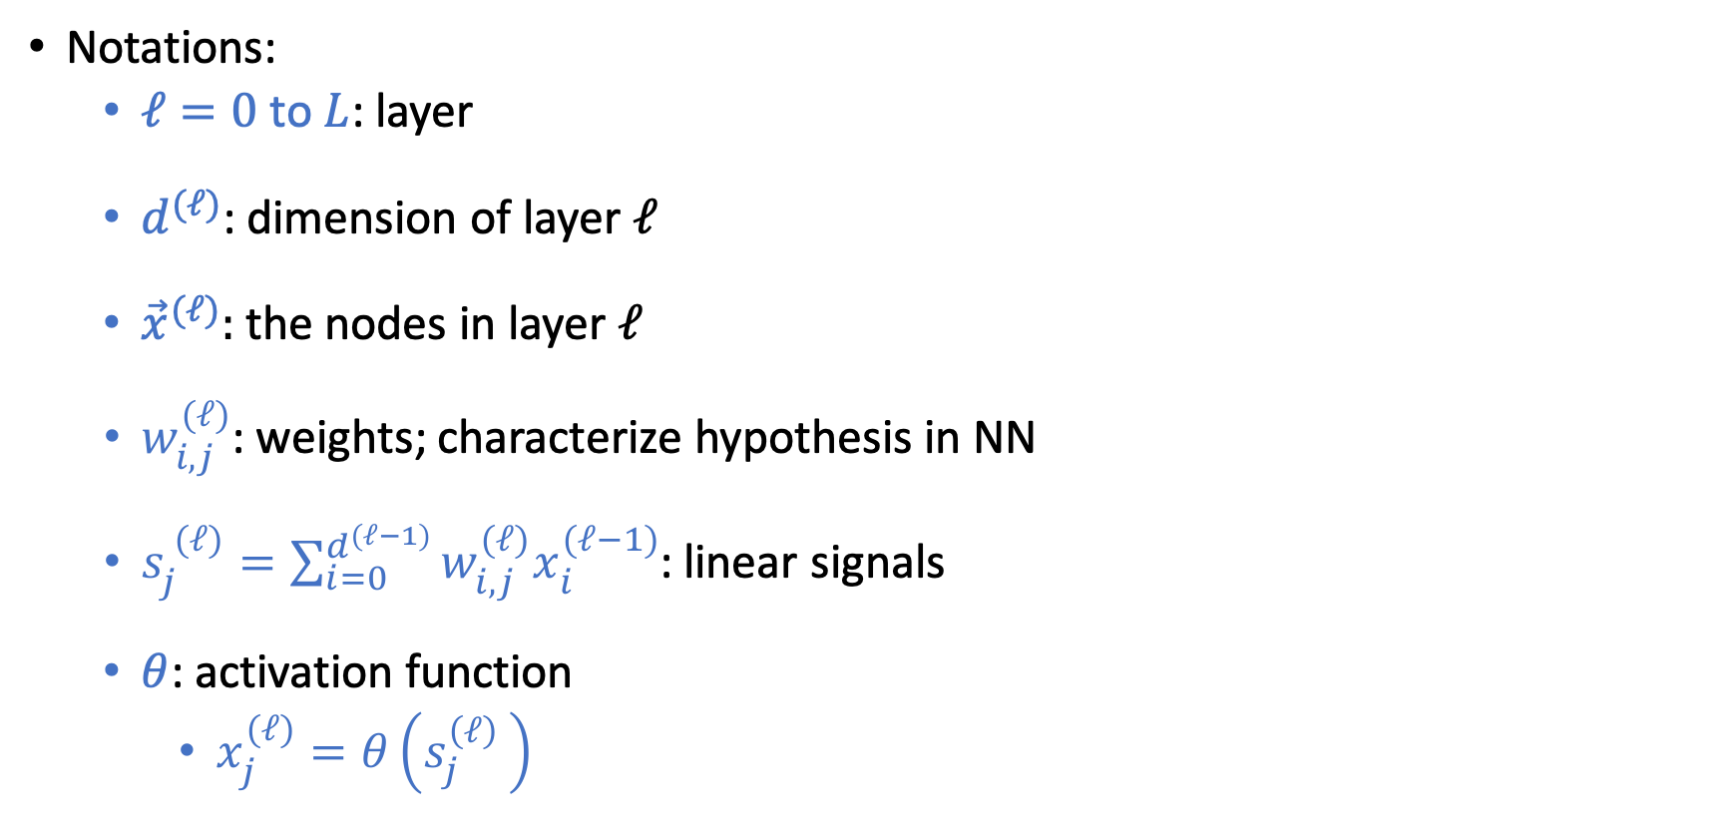
Neural Networks (NN)
Feed-forward network
Notations:
$ℓ=0$ to $L$: layer
$d^{(ℓ)}$: dimension of layer $ℓ$
${\vec{x}}^{(ℓ)}:$ the nodes in layer $ℓ$
$w_{i,j}^{(ℓ)}$: weights; characterize hypothesis in NN
$s_{j}^{ (ℓ)}=\sum_{i=0}^{d^{(ℓ−1)}}{w_{i,j}^{(ℓ)}x_{i}^{(ℓ−1)}}$: linear signals
$θ$: activation function
$x_{j}^{(ℓ)}=θ\left(s_{j}^{\left(ℓ\right) }\right)$
Notes:
4x2 + 3x1 = 11

Slide 5
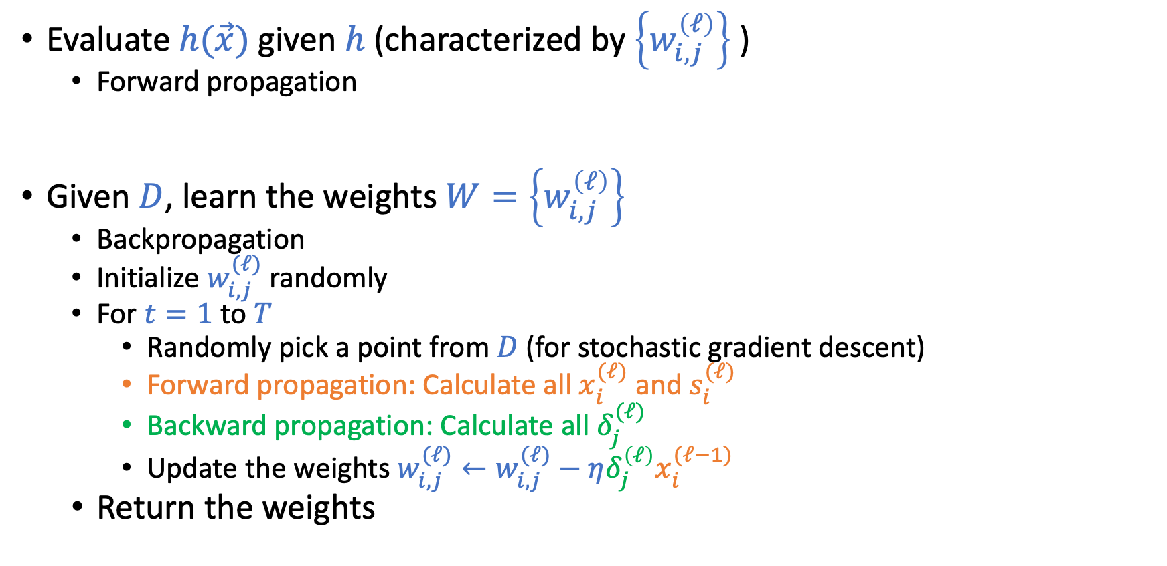
Forward Propagation and Backpropagation
Evaluate $h(\vec{x})$ given $h$ (characterized by $\left\{w_{i,j}^{\left(ℓ\right)}\right\}$ )
Forward propagation
Given $D$, learn the weights $W=\left\{w_{i,j}^{\left(ℓ\right)}\right\}$
Backpropagation
Initialize $w_{i,j}^{(ℓ)}$randomly
For $t=1$ to $T$
Randomly pick a point from $D$ (for stochastic gradient descent)
Forward propagation: Calculate all $x_{i}^{(ℓ)}$ and $s_{i}^{(ℓ)}$
Backward propagation: Calculate all $δ_{j}^{(ℓ)}$
Update the weights $w_{i,j}^{(ℓ)}←w_{i,j}^{(ℓ)}−η{δ_{j}^{\left(ℓ\right)}x}_{i}^{(ℓ−1)}$
Return the weights

Slide 6
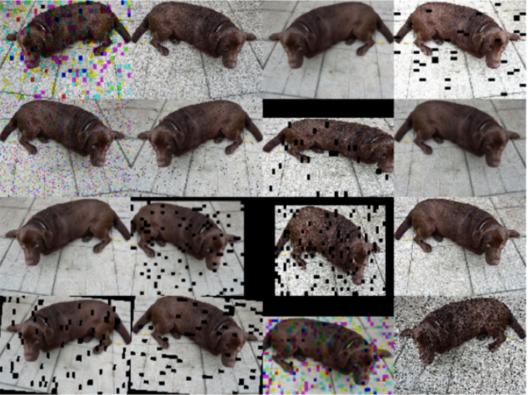

Regularizations in Neural Networks
Weight-based regularization
Early stopping
Dropout
Adding noises

Slide 7
Today’s Lecture
The notes are not intended to be comprehensive. They should be accompanied by lectures and/or textbook.
Let me know if you spot errors.
Notes:
This is the lecture I wish I have 6 chalkboards to utilize

Slide 8
Deep Learning
Neural networks with many layers

Slide 9
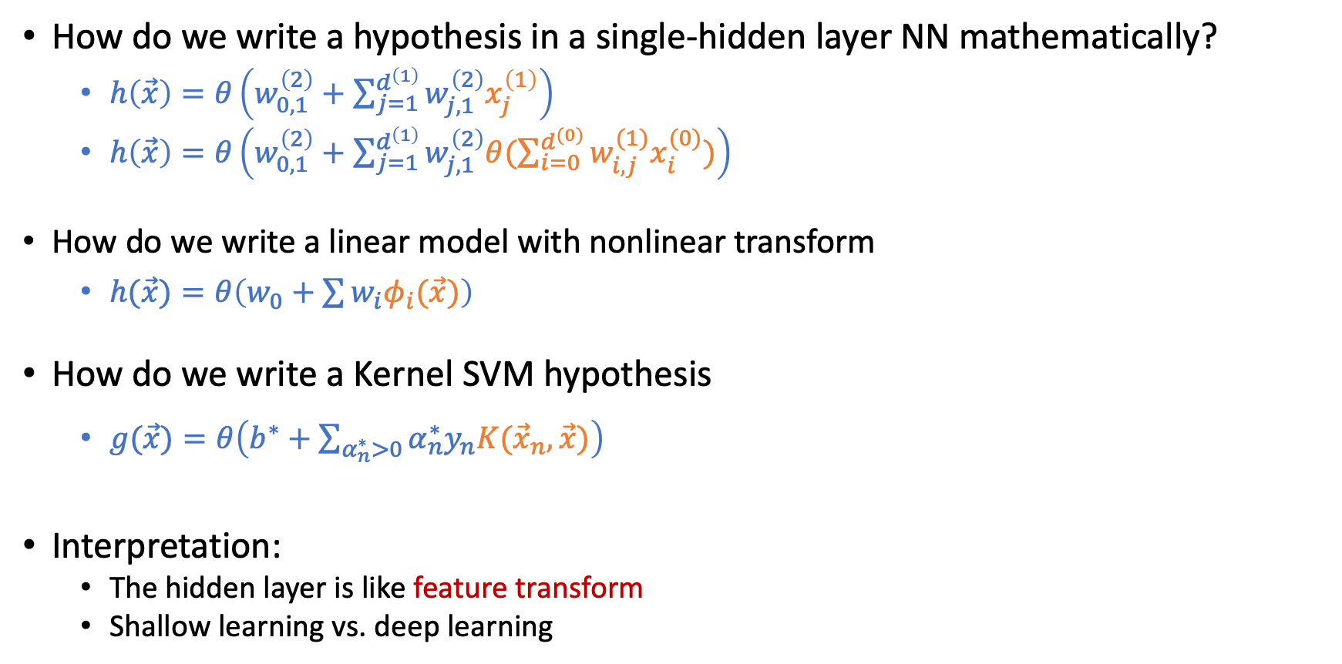
Single Hidden-Layer Neural Network
How do we write a hypothesis in a single-hidden layer NN mathematically?
$h\left(\vec{x}\right)=θ\left(w_{0,1}^{\left(2\right)}+\sum_{j=1}^{d^{\left(1\right)}}{w_{j,1}^{\left(2\right)}x_{j}^{\left(1\right)}}\right)$
$h\left(\vec{x}\right)=θ\left(w_{0,1}^{\left(2\right)}+\sum_{j=1}^{d^{\left(1\right)}}{w_{j,1}^{\left(2\right)}θ(\sum_{i=0}^{d^{(0)}}{w_{i,j}^{(1)}x_{i}^{(0)}})}\right)$
How do we write a linear model with nonlinear transform
$h(\vec{x})=θ\left(w_{0}+\sum{w_{i}φ_{i}(\vec{x})}\right)$
How do we write a Kernel SVM hypothesis
$g(\vec{x})=θ\left(b^{∗}+\sum_{α_{n}^{∗}>0}{α_{n}^{∗}y_{n}K({\vec{x}}_{n},\vec{x})}\right)$
Interpretation:
The hidden layer is like feature transform
Shallow learning vs. deep learning

Slide 10
Deep Neural Network
“Shallow” neural network is powerful (universal approximation theorem holds with a single hidden layer). Why “deep” neural networks?
Each layer captures features
of the previous layers.
We can use “raw data” (e.g., pixels of an image) as input. The hidden layer are extracting the features.
Design different network architectures to incorporate domain knowledge.

Slide 11


Convolutional Neural Networks (CNN)
Captures the localized properties of features hierarchically

Slide 12

Convolutional Filters
A convolutional filter is like a matrix version of a dot product.
0 | 0 | 0 | 0 | 0 | 0
0 | 1 | 2 | 2 | 1 | 0
0 | 2 | 4 | 4 | 2 | 0
0 | 1 | 3 | 3 | 1 | 0
0 | 1 | 2 | 3 | 1 | 0
0 | 0 | 1 | 1 | 0 | 0
0 | 1 | 0
1 | -4 | 1
0 | 1 | 0
$$∗$$

Slide 13

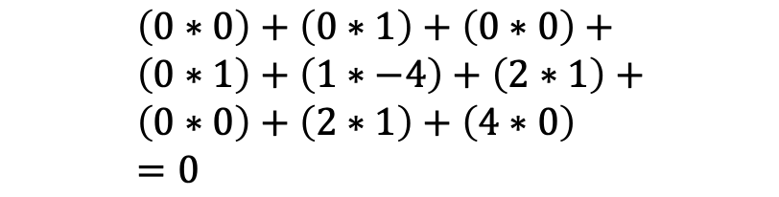
Convolutional Filters
A convolutional filter is like a matrix version of a dot product.
0 | 0 | 0 | 0 | 0 | 0
0 | 1 | 2 | 2 | 1 | 0
0 | 2 | 4 | 4 | 2 | 0
0 | 1 | 3 | 3 | 1 | 0
0 | 1 | 2 | 3 | 1 | 0
0 | 0 | 1 | 1 | 0 | 0
0
0 | 1 | 0
1 | -4 | 1
0 | 1 | 0
$$∗$$
$$=$$
$$\left(0∗0\right)+\left(0∗1\right)+\left(0∗0\right)+ \\ \left(0∗1\right)+\left(1∗−4\right)+\left(2∗1\right)+ \\ \left(0∗0\right)+\left(2∗1\right)+\left(4∗0\right) \\ =0$$

Slide 14
Convolutional Filters
A convolutional filter is like a matrix version of a dot product.
0 | 0 | 0 | 0 | 0 | 0
0 | 1 | 2 | 2 | 1 | 0
0 | 2 | 4 | 4 | 2 | 0
0 | 1 | 3 | 3 | 1 | 0
0 | 1 | 2 | 3 | 1 | 0
0 | 0 | 1 | 1 | 0 | 0
0
0 | 1 | 0
1 | -4 | 1
0 | 1 | 0
$$∗$$
$$=$$

Slide 15
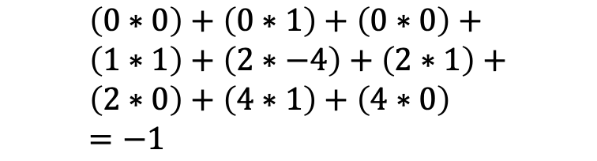
Convolutional Filters
A convolutional filter is like a matrix version of a dot product.
0 | 0 | 0 | 0 | 0 | 0
0 | 1 | 2 | 2 | 1 | 0
0 | 2 | 4 | 4 | 2 | 0
0 | 1 | 3 | 3 | 1 | 0
0 | 1 | 2 | 3 | 1 | 0
0 | 0 | 1 | 1 | 0 | 0
0 | -1
0 | 1 | 0
1 | -4 | 1
0 | 1 | 0
$$∗$$
$$=$$
$$\left(0∗0\right)+\left(0∗1\right)+\left(0∗0\right)+ \\ \left(1∗1\right)+\left(2∗−4\right)+\left(2∗1\right)+ \\ \left(2∗0\right)+\left(4∗1\right)+\left(4∗0\right) \\ =−1$$

Slide 16
Convolutional Filters
A convolutional filter is like a matrix version of a dot product.
0 | 0 | 0 | 0 | 0 | 0
0 | 1 | 2 | 2 | 1 | 0
0 | 2 | 4 | 4 | 2 | 0
0 | 1 | 3 | 3 | 1 | 0
0 | 1 | 2 | 3 | 1 | 0
0 | 0 | 1 | 1 | 0 | 0
0 | -1 | -1 | 0
-2 | -5 | -5 | -2
2 | -2 | -1 | 3
-1 | 0 | -5 | 0
0 | 1 | 0
1 | -4 | 1
0 | 1 | 0
$$∗$$
$$=$$

Slide 17
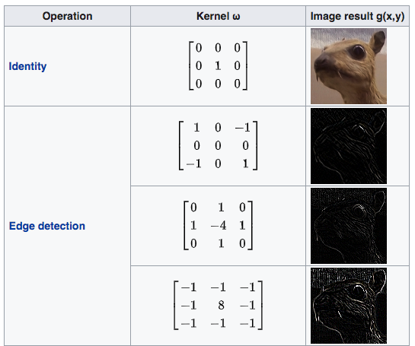

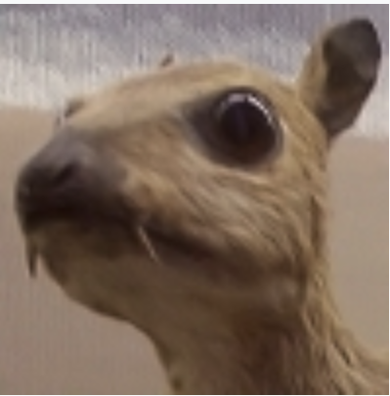
Convolutional Filters
https://en.wikipedia.org/wiki/Kernel_(image_processing)

Slide 18
Convolutional Filters
https://en.wikipedia.org/wiki/Kernel_(image_processing)

Slide 19
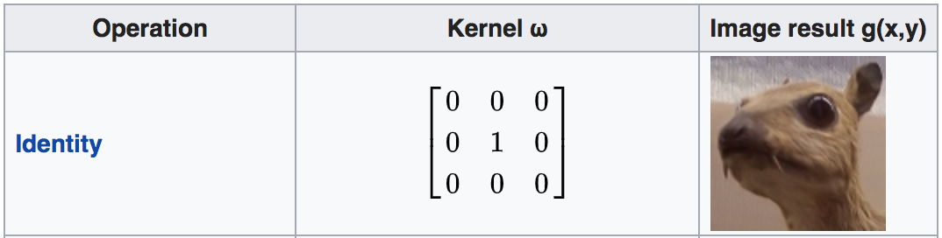
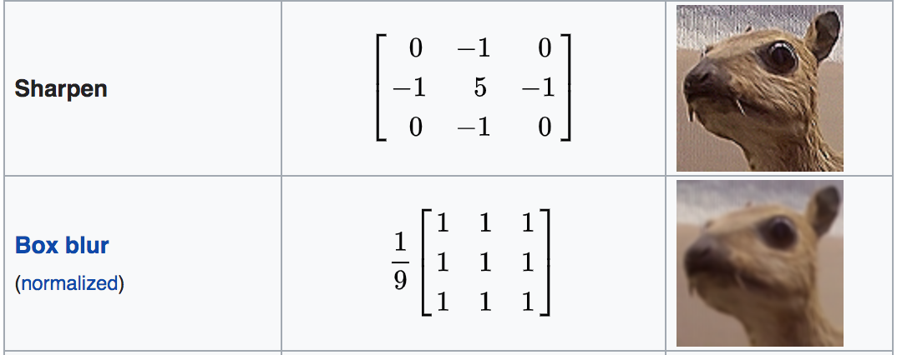
Convolutional Filters
https://en.wikipedia.org/wiki/Kernel_(image_processing)

Slide 20
Convolutional Filters
https://en.wikipedia.org/wiki/Kernel_(image_processing)

Slide 21


Connection to Neural Networks
Convolutions can be represented by a network structure
Nodes in the previous layer are only connected to “adjacent” nodes in the next layer.
Many of the weights have the same value.
0 | 0 | 0 | 0 | 0 | 0
0 | 1 | 2 | 2 | 1 | 0
0 | 2 | 4 | 4 | 2 | 0
0 | 1 | 3 | 3 | 1 | 0
0 | 1 | 2 | 3 | 1 | 0
0 | 0 | 1 | 1 | 0 | 0
0 | -1 | -1 | 0
-2 | -5 | -5 | -2
2 | -2 | -1 | 3
-1 | 0 | -5 | 0
0 | 1 | 0
1 | -4 | 1
0 | 1 | 0
$$∗$$
$$=$$

Slide 22
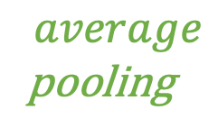
Pooling Layers
Commonly used in convolutional neural networks. A subsampling / down-sampling process:
Combines multiple adjacent nodes into a single node
Reduce the dimensionality of input. More robust to noise.
0 | -1 | -1 | 0
-2 | -5 | -5 | -2
2 | -2 | 2 | 3
-1 | 1 | -5 | 0
-2 | -2
0 | 0
$$average$$
pooling

Slide 23
Convolutional Neural Networks (CNN)
Captures the localized properties of features
Particularly suitable for computer vision (images)
Go (AlphaGo) is another famous application of CNN

Slide 24
Another Example Network Structure [Safe to Skip for the Exam]
Recurrent Neural Network (RNN)
Aim to deal with time-series data, such as natural language processing
Using hidden layers to store temporal information
Allow previous outputs to be used as inputs and keep hidden states
[Images from Wikipedia]

Slide 25
Some Techniques in Improving Deep Learning
Regularization to mitigate overfitting
Weight-based, early stopping, dropout, etc
Incorporating domain knowledges
Network architectures (e.g., Convolutional Neural Nets)
Improving computation with huge amount of data
Hardware architecture to improve parallel computation
Improving gradient-based optimization
Choosing better initialization points

Slide 26
Initialization
Why initialization matters in deep learning
Error is nonconvex in NN
Vanishing/exploding gradient problem

Slide 27

Error is Nonconvex in Neural Networks
We mostly adopt gradient-descent-style algorithms for optimization.
No guarantee to converge to global optimal.
Need to run it many times.
Initialization matters.

Slide 28
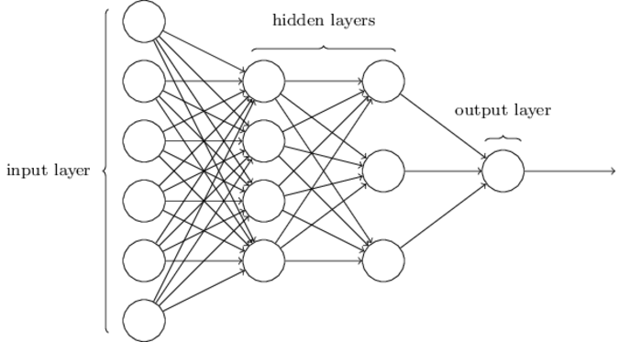
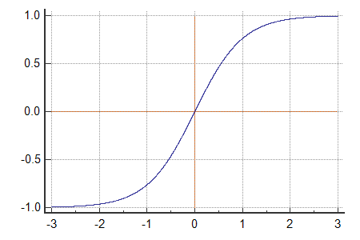
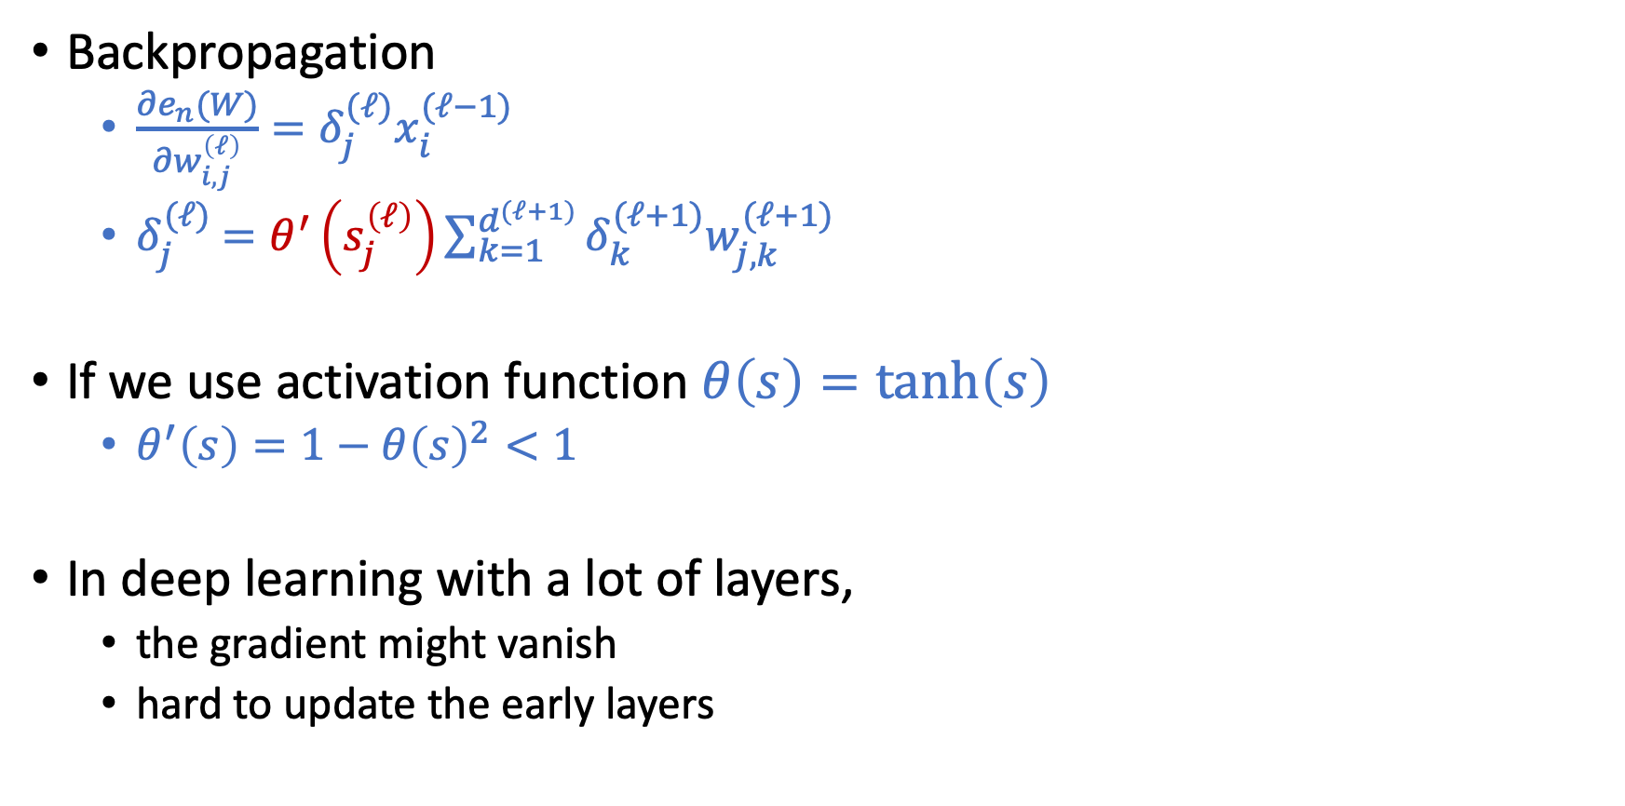
Vanishing Gradient Problem
Backpropagation
$\frac{∂e_{n}(W)}{∂w_{i,j}^{\left(ℓ\right)}}=δ_{j}^{(ℓ)}x_{i}^{(ℓ−1)}$
$δ_{j}^{(ℓ)}$ $=θ^{′}\left(s_{j}^{\left(ℓ\right)}\right)\sum_{k=1}^{d^{(ℓ+1)}}{δ_{k}^{(ℓ+1)}w_{j,k}^{(ℓ+1)}}$
If we use activation function $θ\left(s\right)=\tanh\left(s\right)$
$θ^{′}\left(s\right)=1−θ{\left(s\right)}^{2}<1$
In deep learning with a lot of layers,
the gradient might vanish
hard to update the early layers

Slide 29
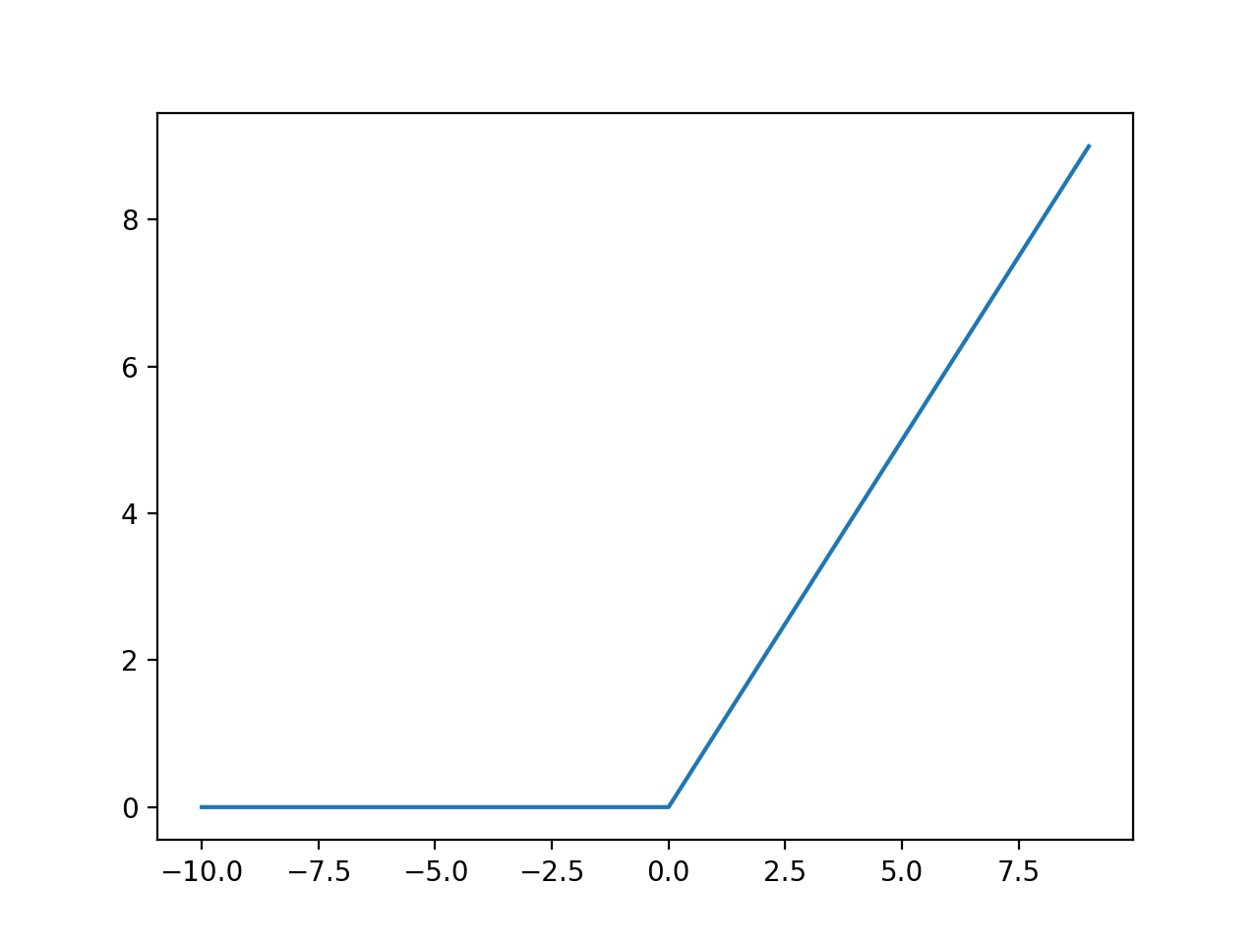
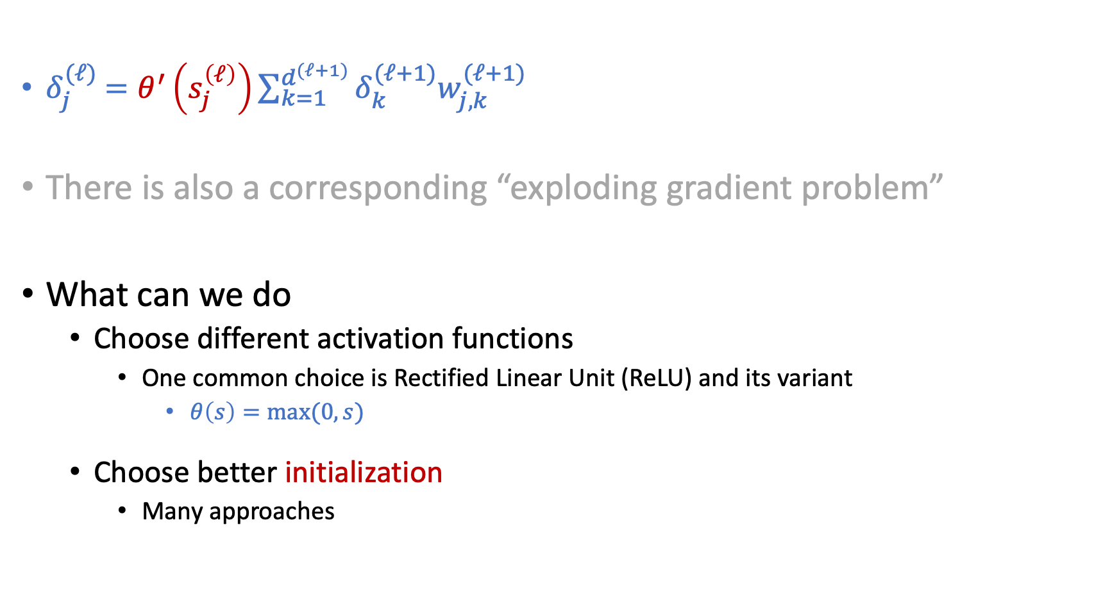
Vanishing Gradient Problem
$δ_{j}^{(ℓ)}$ $=θ^{′}\left(s_{j}^{\left(ℓ\right)}\right)\sum_{k=1}^{d^{(ℓ+1)}}{δ_{k}^{(ℓ+1)}w_{j,k}^{(ℓ+1)}}$
There is also a corresponding “exploding gradient problem”
What can we do
Choose different activation functions
One common choice is Rectified Linear Unit (ReLU) and its variant
$θ\left(s\right)=max⁡(0,s)$
Choose better initialization
Many approaches

Slide 30
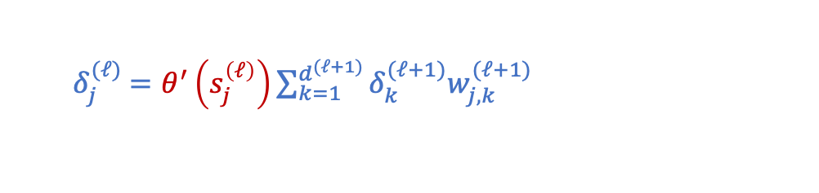
Weight Initialization
Initializing weights to all 0 is a bad idea
Q6b of HW1
Hint: Look at the backpropagation formulation
Randomly Initializing weights to regions so that vanishing/exploding gradients are less likely to happen
Activation-function dependent
e.g., Xavier initialization for tanh
Learning the initialization that might be closer to the optimal
E.g., using autoencoder
$δ_{j}^{(ℓ)}$ $=θ^{′}\left(s_{j}^{\left(ℓ\right)}\right)\sum_{k=1}^{d^{(ℓ+1)}}{δ_{k}^{(ℓ+1)}w_{j,k}^{(ℓ+1)}}$

Slide 31
Initialization
Hard to initialize the entire network well.
Intuition: Initialize the weights layer by layer such that each layer preserves the properties of the previous layer.

Slide 32


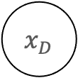
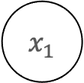



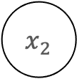
Autoencoders
$$1$$
$$1$$
$$1$$
$$x_{1}$$
$$θ$$
……
$$x_{2}$$
$$θ$$
$$⋮$$
$$x_{D}$$
The hidden layer can be considered as a feature transform. Can we ensure this transformation contain as much information about the original input as possible?

Slide 33
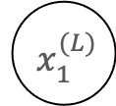
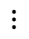
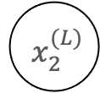
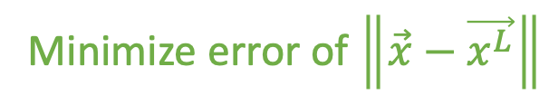
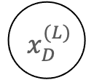
Autoencoders
$$1$$
$$1$$
$$1$$
$$x_{1}$$
$${ x}_{1}^{(L)}$$
$$θ$$
$$x_{2}$$
$${ x}_{2}^{(L)}$$
$$θ$$
$$⋮$$
$$⋮$$
$$x_{D}$$
$${ x}_{D}^{(L)}$$
Minimize error of $\left\|\vec{x}−\vec{x^{L}}\right\|$

Slide 34
Autoencoders
$$1$$
$$1$$
$$1$$
$$x_{1}$$
$${ x}_{1}^{(L)}$$
$$θ$$
$$x_{2}$$
$${ x}_{2}^{(L)}$$
$$θ$$
$$⋮$$
$$⋮$$
$$x_{D}$$
$${ x}_{D}^{(L)}$$
Encoder
Decoder

Slide 35
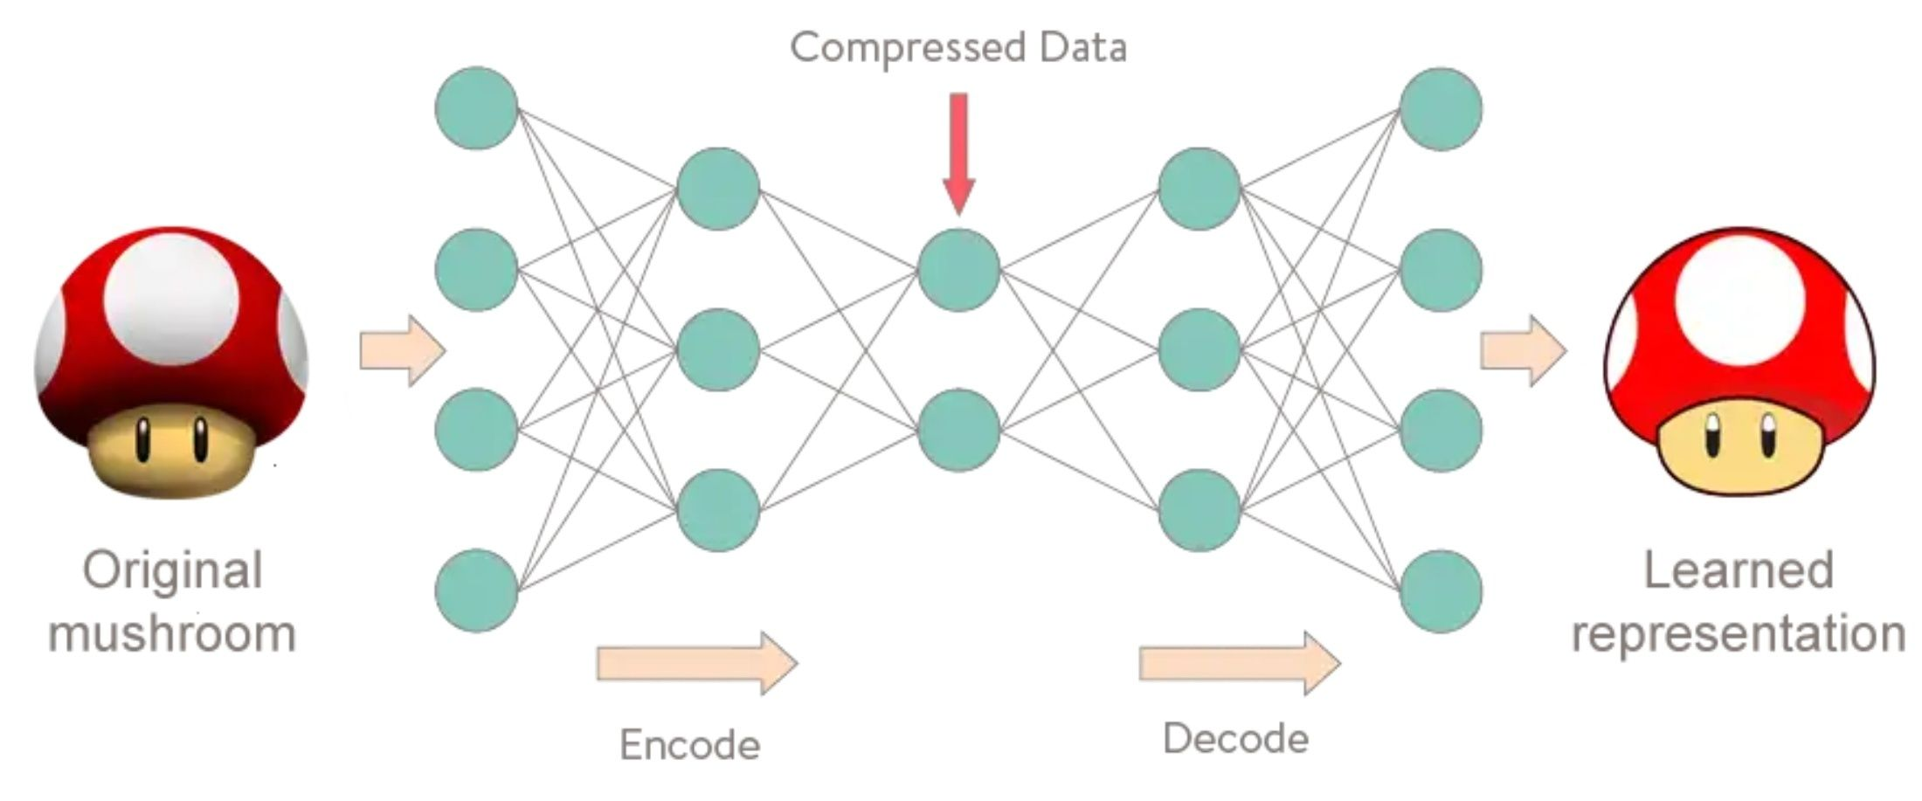
Autoencoder
Unsupervised learning!
https://www.meetup.com/Le-Mans-School-of-AI/photos/29159837/477498782/

Slide 36
Cool Stuffs for Deep Learning
[Safe to Skip for the exam]

Slide 37
Generative Adversarial Nets (GAN)
A Competition: Generator vs Discriminator
Discriminator wants to correctly classify the images (true images or not)
Generator wants to generate images that discriminator can’t classify
[Safe to Skip for the Exam]

Slide 38
https://thisPersonDoesNotExist.com/

Slide 39
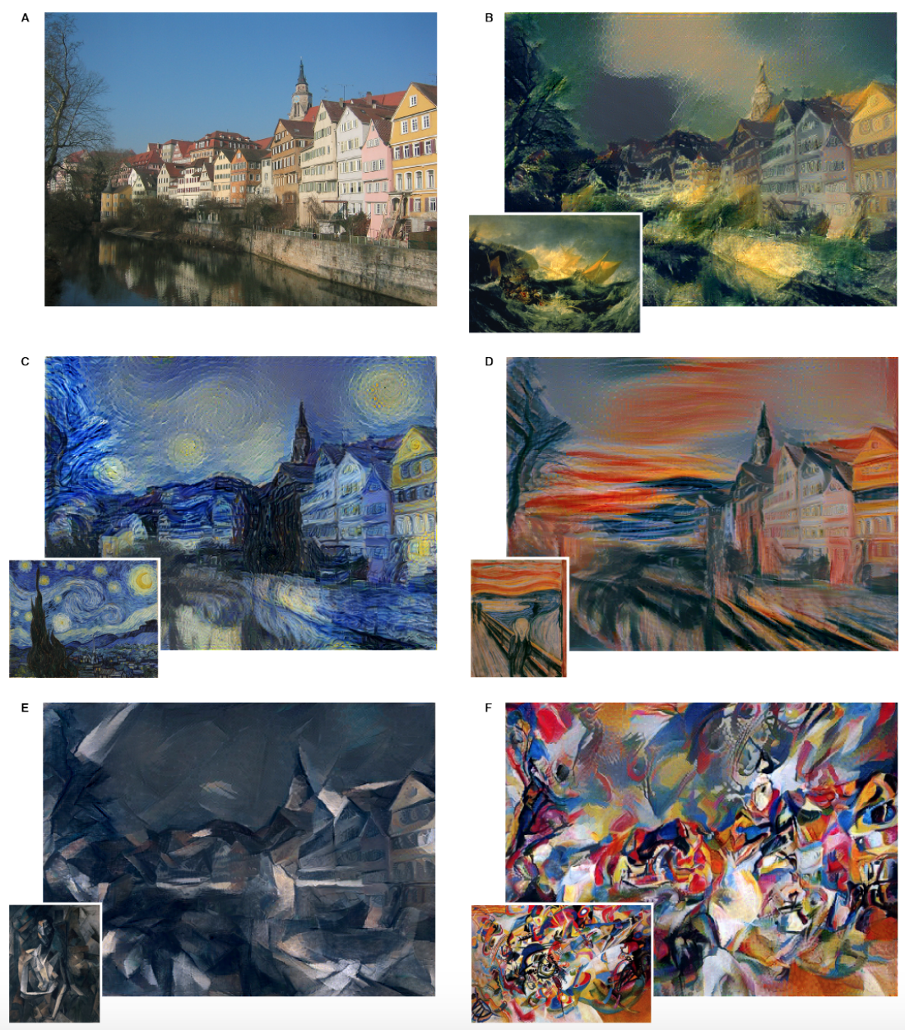
Style Transfer
Informal intuitions:
Recall that we can treat hidden layers as feature transforms
Deep learning is learning representation of data
How to achieve style transfer:
Learn a content representation for an image using hidden layers
Learn a style representation for an image using hidden layers
Compute an image that jointly minimizes the distance from the content image’s content representation and the style image’s style representation
https://arxiv.org/pdf/1508.06576.pdf
[Safe to Skip for the Exam]

Slide 40
A Quick Flashback to RBF

Slide 41
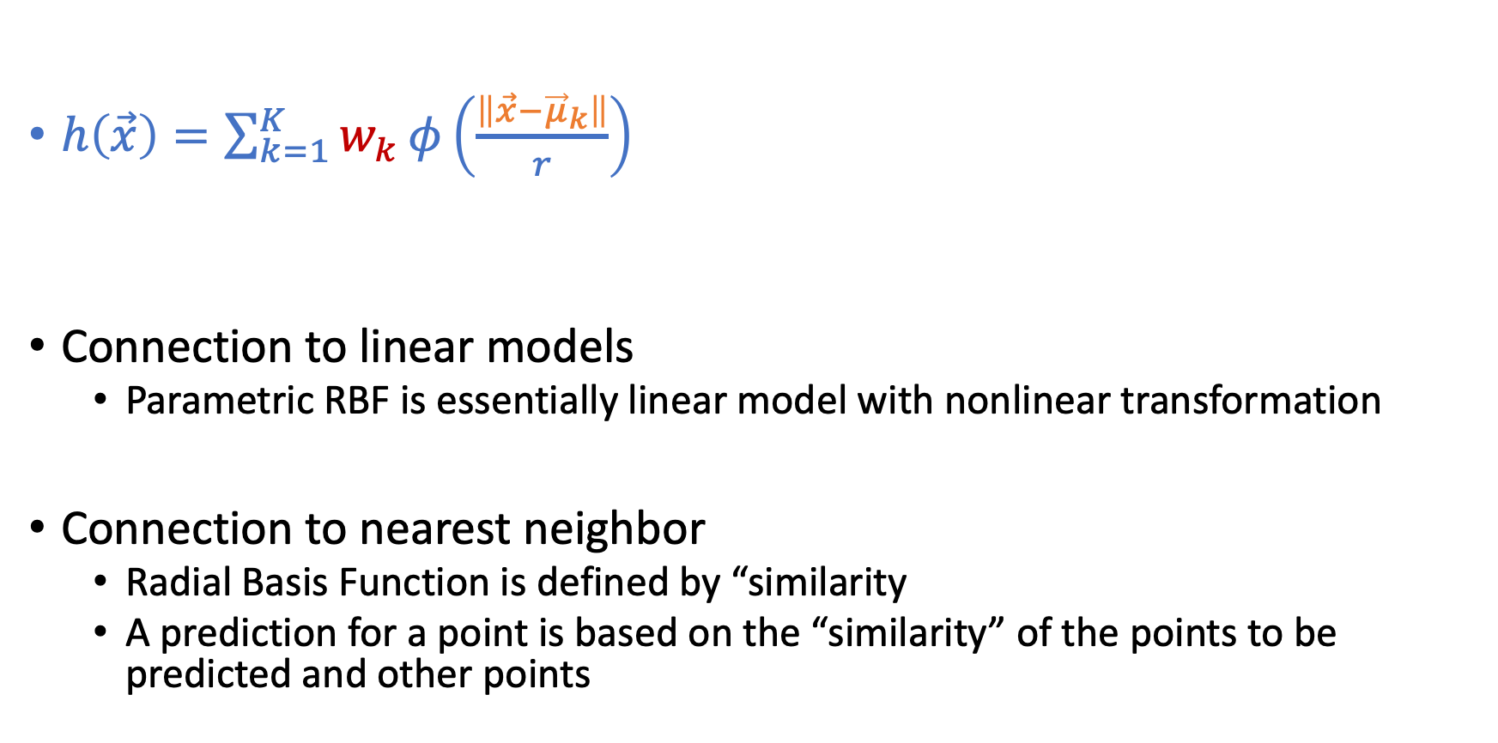
RBF Function
$h\left(\vec{x}\right)=\sum_{k=1}^{K}{w_{k}}φ\left(\frac{\left\|\vec{x}−{\vec{μ}}_{k}\right\|}{r}\right)$
Connection to linear models
Parametric RBF is essentially linear model with nonlinear transformation
Connection to nearest neighbor
Radial Basis Function is defined by “similarity
A prediction for a point is based on the “similarity” of the points to be predicted and other points

Slide 42
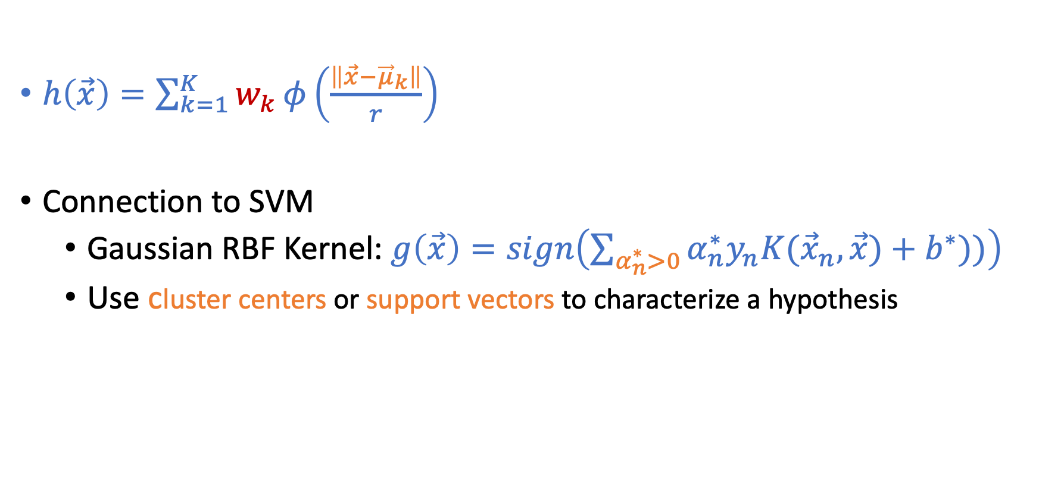
More Discussion on RBF
$h\left(\vec{x}\right)=\sum_{k=1}^{K}{w_{k}}φ\left(\frac{\left\|\vec{x}−{\vec{μ}}_{k}\right\|}{r}\right)$
Connection to SVM
Gaussian RBF Kernel: $g\left(\vec{x}\right)=sign\left(\sum_{α_{n}^{∗}>0}{α_{n}^{∗}y_{n}K({\vec{x}}_{n},\vec{x})}+b^{∗}))\right)$
Use cluster centers or support vectors to characterize a hypothesis
SVM
RBF

Slide 43
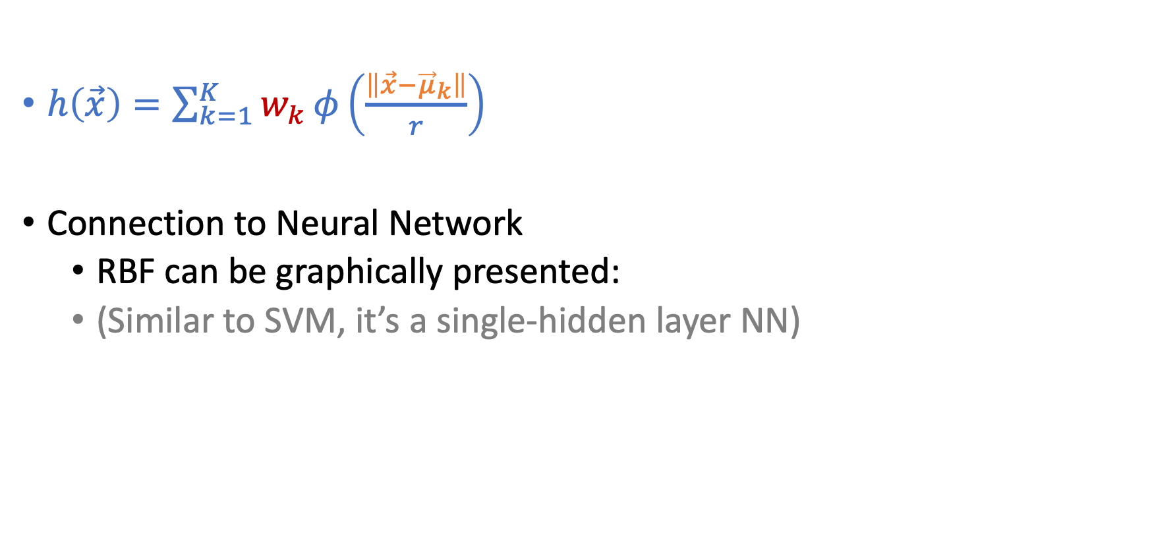
More Discussion on RBF
$h\left(\vec{x}\right)=\sum_{k=1}^{K}{w_{k}}φ\left(\frac{\left\|\vec{x}−{\vec{μ}}_{k}\right\|}{r}\right)$
Connection to Neural Network
RBF can be graphically presented:
(Similar to SVM, it’s a single-hidden layer NN)

Slide 44
Machine Learning Life Cycle

Slide 45
Machine Learning Lifecycle
Feedback
Task Definition
Deployment
Dataset Construction
Testing
Model Definition
Training

Slide 46
Machine Learning Lifecycle
Feedback
Task Definition
Deployment
Dataset Construction
What we covered
(and majority of ML research)
Testing
Model Definition
Training

Slide 47
Machine Learning Lifecycle
To have “positive” impacts, we need to be careful in every stage
Feedback
Task Definition
Deployment
Dataset Construction
What we covered
(and majority of ML research)
Testing
Model Definition
Training

Slide 48
Strategic Classification
Or more recently, people start to call it “performative prediction”

Slide 49
Supervised Learning
Standard setup of (supervised) machine learning
Finding patterns from the given training datasets
Use the pattern to make predictions on new testing data
Fundamental assumption:
Training and testing data points are i.i.d. drawn from the same distribution

Slide 50
Example: Spam Filter

Slide 51
Example: Spam Filter

Slide 52
Example: Spam Filter

Slide 53
Social Program Eligibility [Camacho and Conover, 2012]
Notes:
Social welfare program in Columbia

Slide 54
Goodhart’s law:
“If a measure becomes the public’s goal, it is no longer a good measure.”

Slide 55

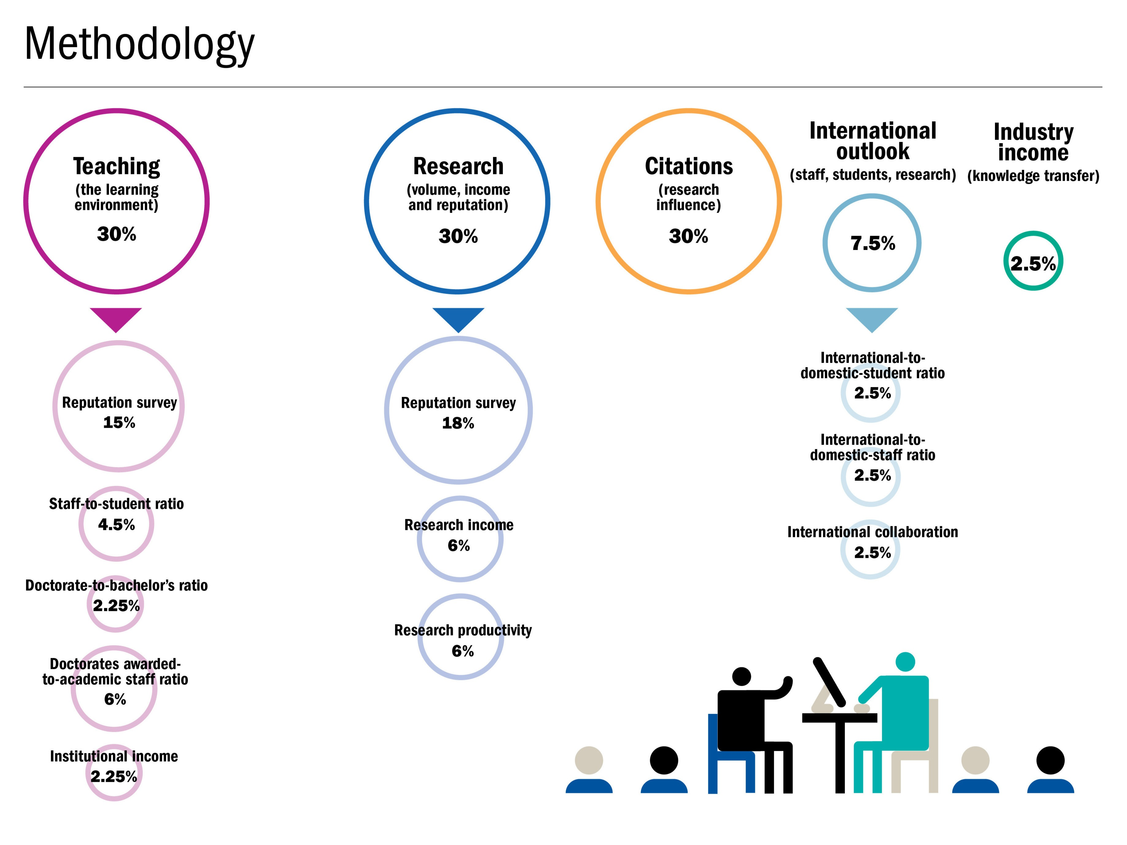

Slide 56
Strategic Classification

Slide 57
Machine Learning Lifecycle
Feedback
Task Definition
Deployment
Dataset Construction
Testing
Model Definition
Training

Slide 58
How to take this interaction between ML algorithms and data-holders into account?
Game theoretical modeling

Slide 59
Game Theoretical Modeling
Key elements:
Players, actions, payoffs
Players: Jury (e.g., university) and Contestants (student applicants)
Actions:
First, Jury decides on the machine learning model (binary classification)
Then, Contestant decides how to alter their features based on the model
Payoffs
Jury wants to maximize the probability of correct predictions
Contestants want to be selected (being predicted as 1)

Slide 60
More Aspects of Strategic Classification
Evaluation vs. Incentive

Slide 61

Types of Manipulations
Say that your insurance company wants you to stay healthy (so they can pay less) and decide reward you if you hit the step target on your phone.

Slide 62
Gaming vs. Improvement
Gaming
Alter the decision by manipulating proxy features without changing the underlying label
Unjustifiable or pointless effort
What’s considered in the required reading
Improvement
Change the decision by manipulation that changes the underlying label
Maybe this is the positive effect that we want to utilize

Slide 63
The Purposes of Decision Rules
To evaluate the candidates
Assume there is a true unobservable quality that we care about
e.g., whether the student will succeed or not
Unobservable quality leads to observable but manipulatable features
Aims to classify based on the true quality with gaming behavior
To incentivize the candidates
Assume the true unobservable quality can be improved
Incentivize candidates to perform desired improvements

